Slide 1
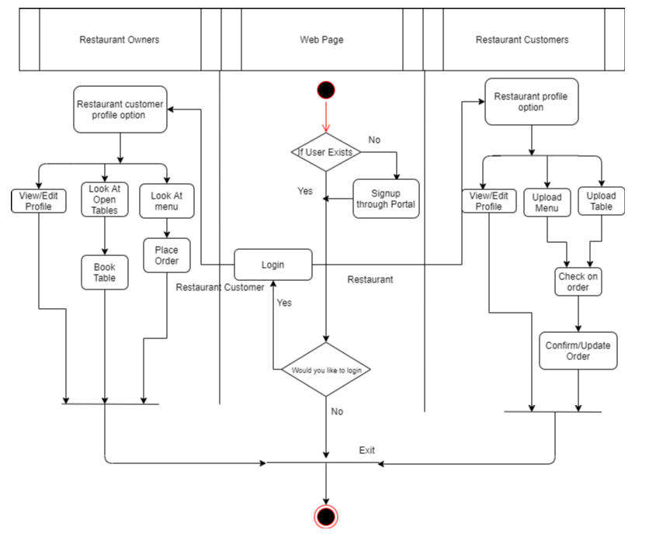
Super Servoli Systems - Activity Diagram

